Slide 1

Deeper dive and analysis of Starbucks locations
Rice University
Data Analytics and Visualization BootCamp

Slide 2
Team Members
Shahnawaz Khan
Jesus Jasso
Brian Glaude
Felix Gonzalez

Slide 3

Research questions to answer
What states have the most Starbucks locations?
What states have more population per Starbucks location?
What correlation exist between Starbucks stores and income level per state?
This Photo by Unknown Author is licensed under CC BY

Slide 4
Data gathering process
Three data sets:
Source of data - Kaggle
1) Starbucks store location (February 2017) – Directory of stores
2) US Census Demographics (2017) – County by County demographics data
3) Zip codes (2017) – Complete list of Zip codes
Leveraged Pandas and Jupyter
Data Cleanup
1) Removed unnecessary fields, Grouped columns,
3) Counts, averages, sums, and percentages
Created a join key to consolidate all the data into a final data frame.
Once the final data frame was created, we focused on understanding what story the data was telling.

Slide 5
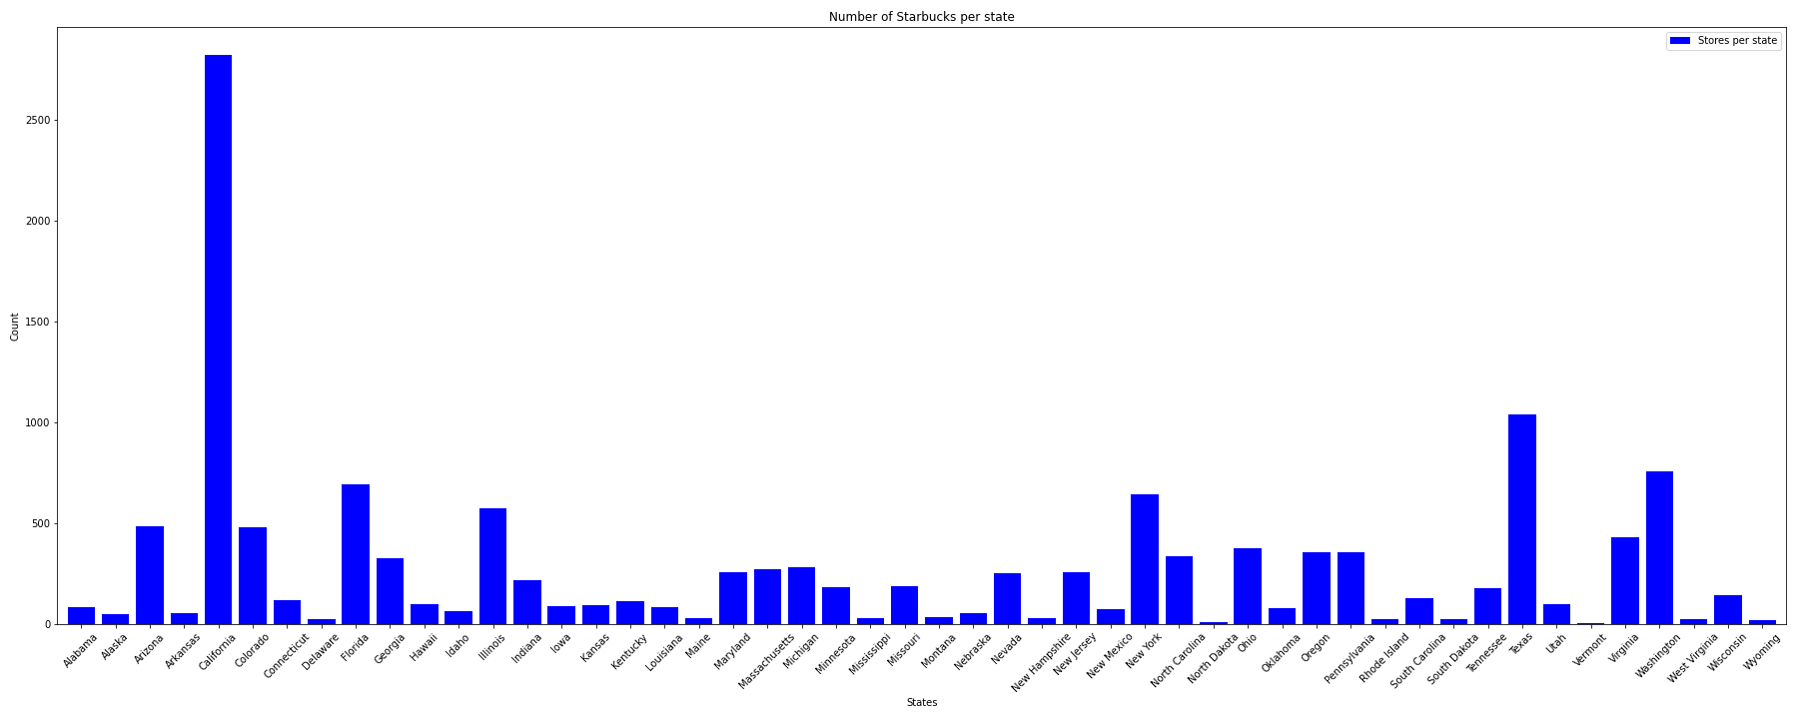
Bar Charts
Key Takeaway
California, Texas and Washington have the most Starbucks stores per state in the US.

Slide 6
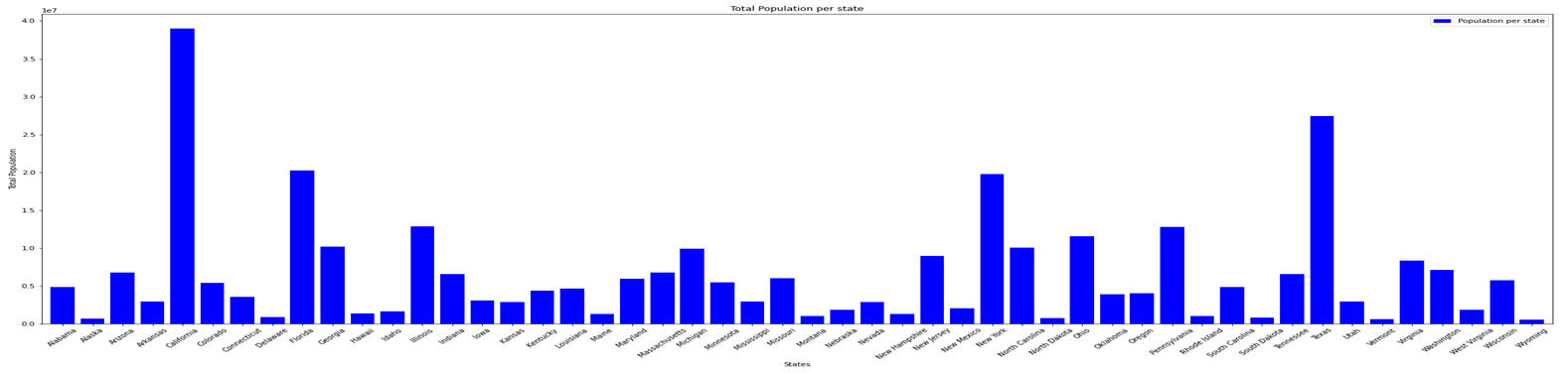
Bar Charts
Key Takeaway
Total number of population per state doesn’t necessarily relate to number of Starbucks stores per state. This is maybe due to space limitations. For example, New York has the fourth largest population in the US but Washington has more Starbucks stores (13th largest population in the US). However, California and Texas have the highest number of Starbucks stores and total population.

Slide 7
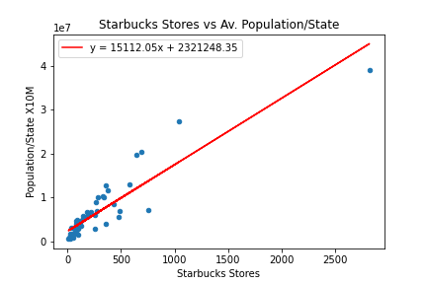
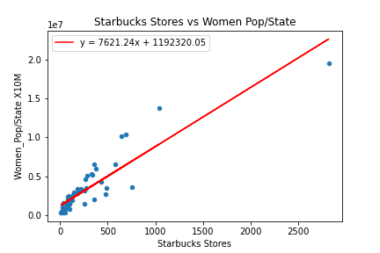
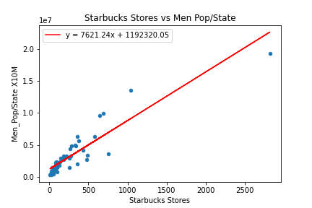
Scatter Plot Charts
Starbucks stores/state vs Total Population/state
Correlation = 0.9
Gender Diversity
Follows the same pattern as Total Population
Apparently good correlation & with higher population /state has higher number of Starbucks stores.

Slide 8
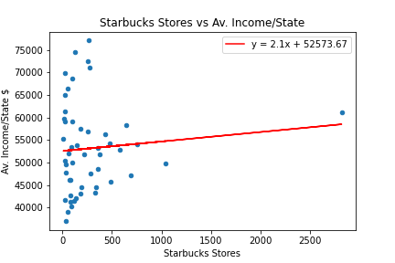
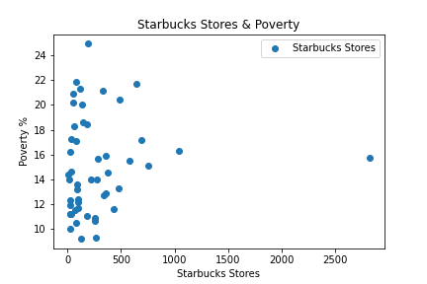
Scatter Plot Charts
Starbucks stores in states vs Av. Income/state
Correlation is very low (0.09)
Starbucks stores/ state vs Av. Poverty/State
It is evident that significant amount of dataset do not follow trend of higher the Ave Income /state – more the Starbucks stores
Similarly higher the poverty level /state do not reflect decrease in stores/state with increase in poverty% /state

Slide 9
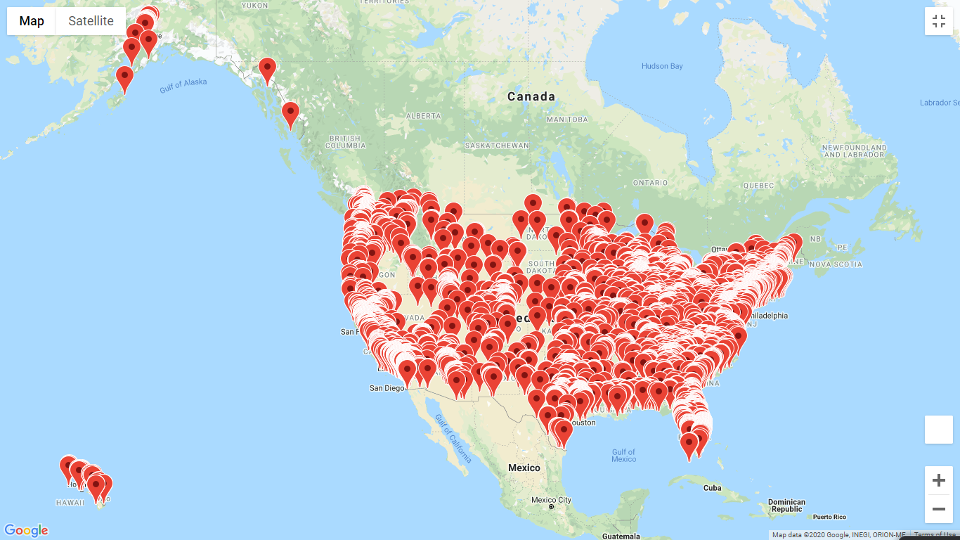
Heat map
Starbucks

Slide 10
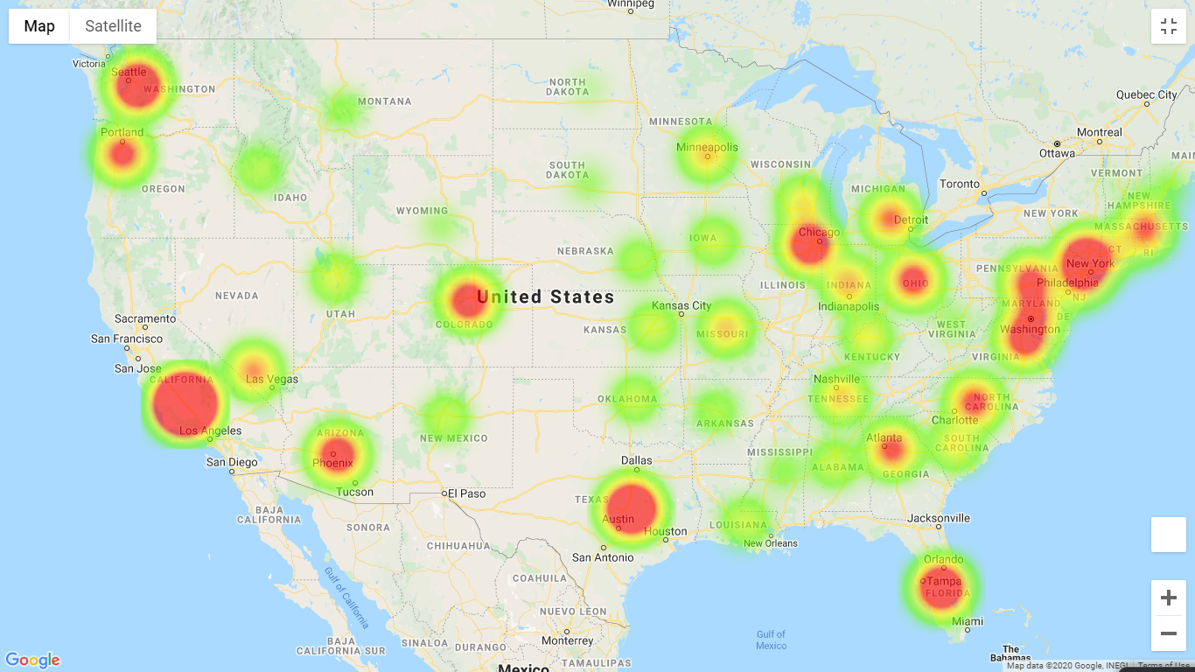
Heat map
Starbucks

Slide 11

Summary conclusion
Our data tells us that Starbucks locations are not correlated to state size, population, gender or income.
We believe that Starbucks has its own strategy to add stores across the country. This strategy may be based on locations where there is more transit of people, work offices or buildings, other stores, etc.

